Slide 1




SALES INSIGHTS – HOTEL BOOKING

Slide 2

PROBLEM STATEMENT
Have you ever wondered when the best time of year to book a hotel room is? Or the optimal length of stay in order to get the best daily rate? What if you wanted to predict whether or not a hotel was likely to receive a disproportionately high number of special requests? This hotel booking dataset can help you explore those questions! This data set contains booking information for a city hotel and a resort hotel and includes information such as when the booking was made, length of stay, the number of adults, children, and/or babies, and the number of available parking spaces, among other things. All personally identifying information has been removed from the data.

Slide 3
DEFINE YOUR BUSINESS OBJECTIVE.
The project aims to gain interesting insight into customers’ behavior when booking a hotel. The demand for different segment of customer may differ and forecasting become harder as it may requires different model for different segment.These insights can guide hotels to adjust their customer strategies and make preparation for unknown.

Slide 4
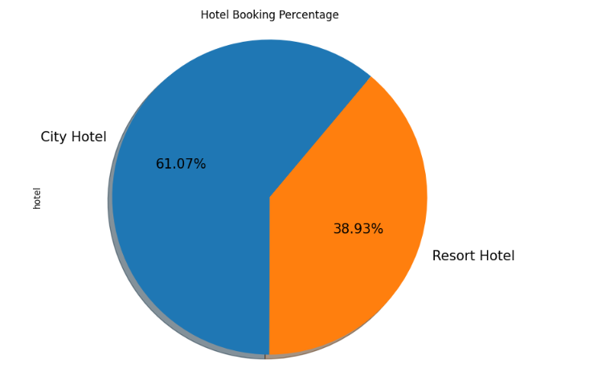
WHICH TYPE OF HOTEL IS MOST PREFERRED BY THE GUESTS?

Slide 5
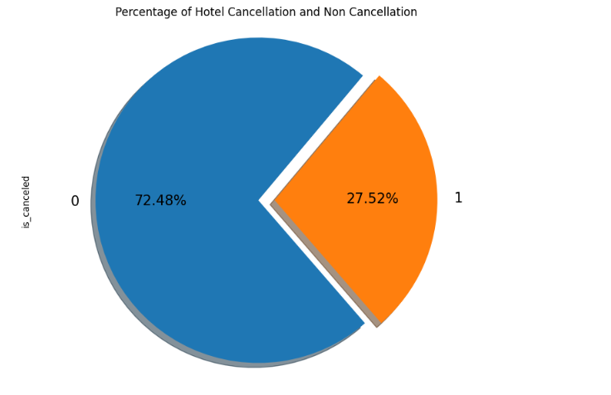
What is the percentage of hotel booking cancellations?

Slide 6
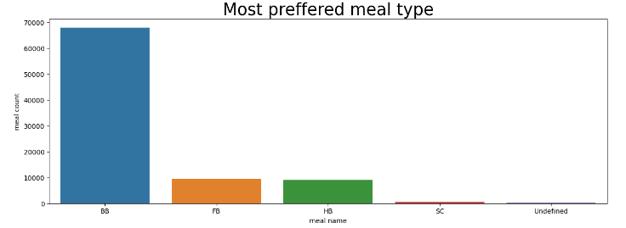
*Which type of meal is most preferred by guests?*

Slide 7
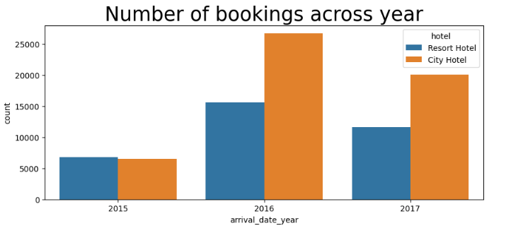
Which year has the most bookings?

Slide 8
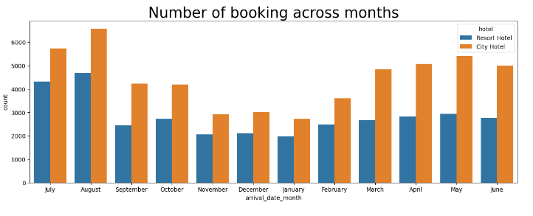
Which month has the most bookings in each hotel type?

Slide 9
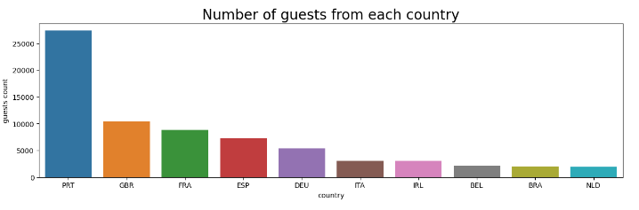
From which country most guests come?

Slide 10
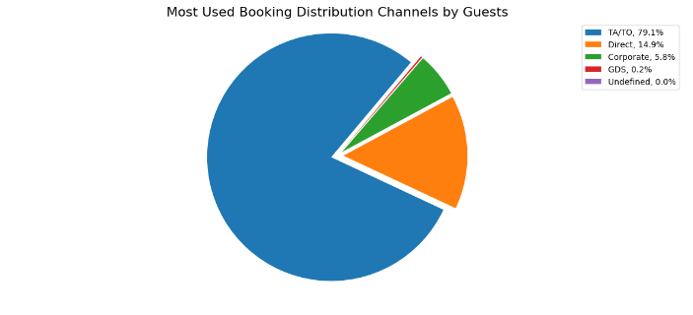
Which distribution channel is most used in booking?

Slide 11
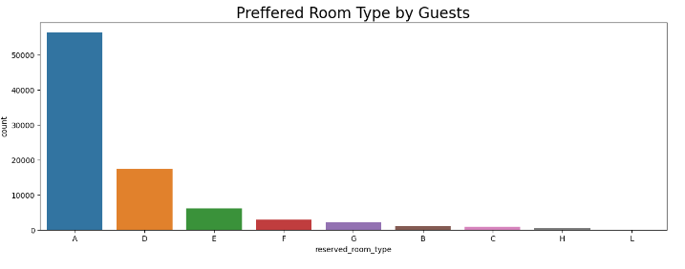
Which room type is most preffered by guests?

Slide 12
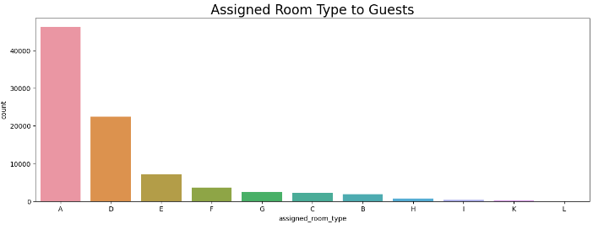
*Which room type is most assigned?*

Slide 13
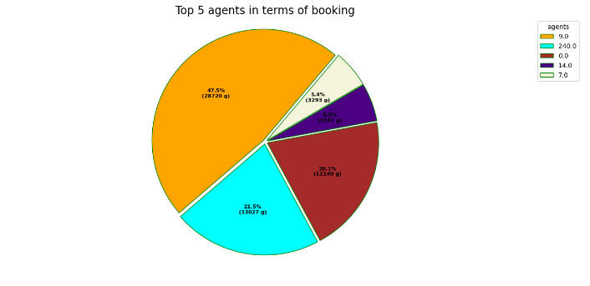
*Top 5 agents in terms of most bookings?*

Slide 14
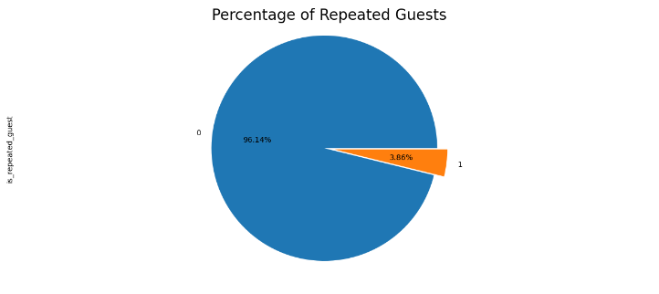
*What is the percentage of repeated guests?*

Slide 15
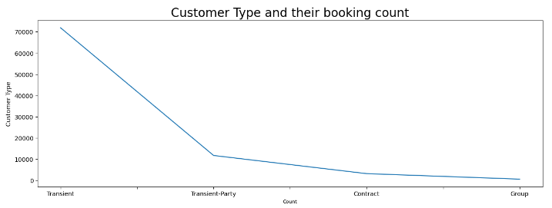
*Which customer type has the most booking?*

Slide 16
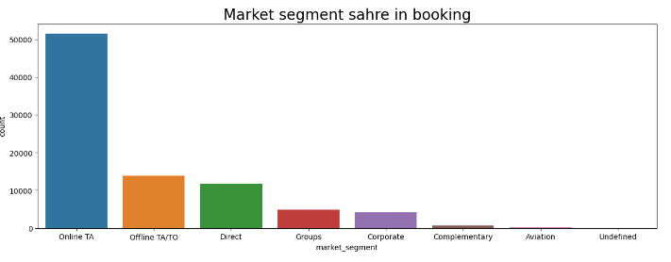
*Which Market Segment has the most booking?*

Slide 17
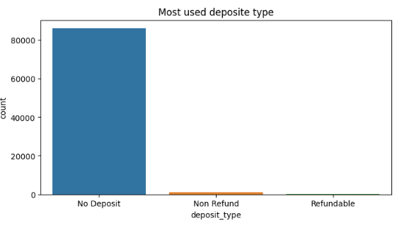
*Which deposite type is most preffered?*

Slide 18
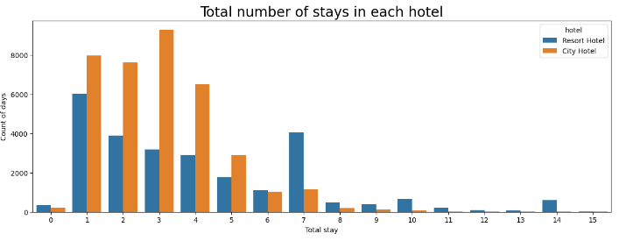
*How long people stay in the hotel?*

Slide 19
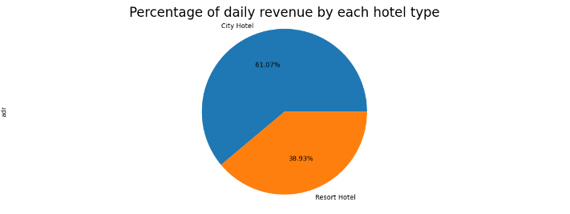
*Which hotel makes most revenue?*

Slide 20
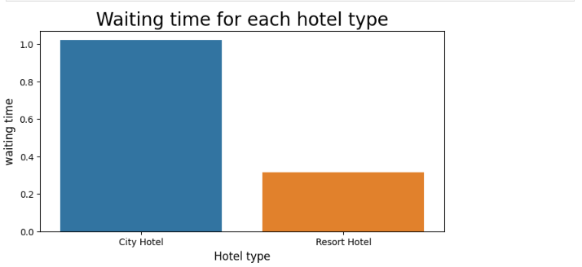
Which hotel has the longer waiting time?

Slide 21
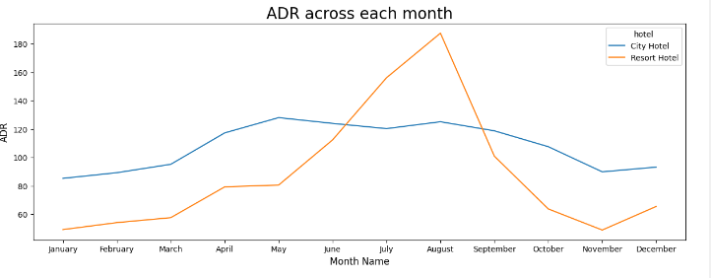
*Which distribution channel has highest adr?*

Slide 22
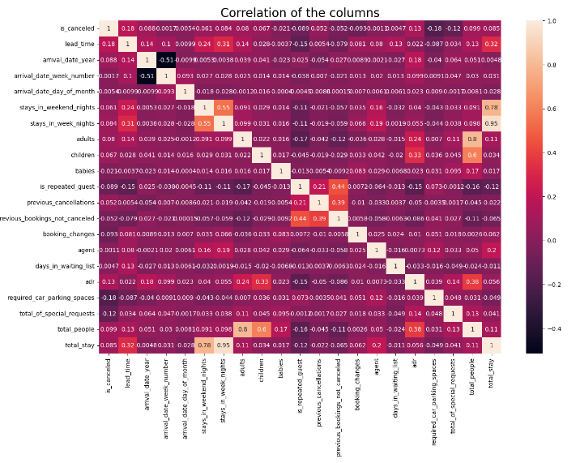
Correlation Heatmap

Slide 23
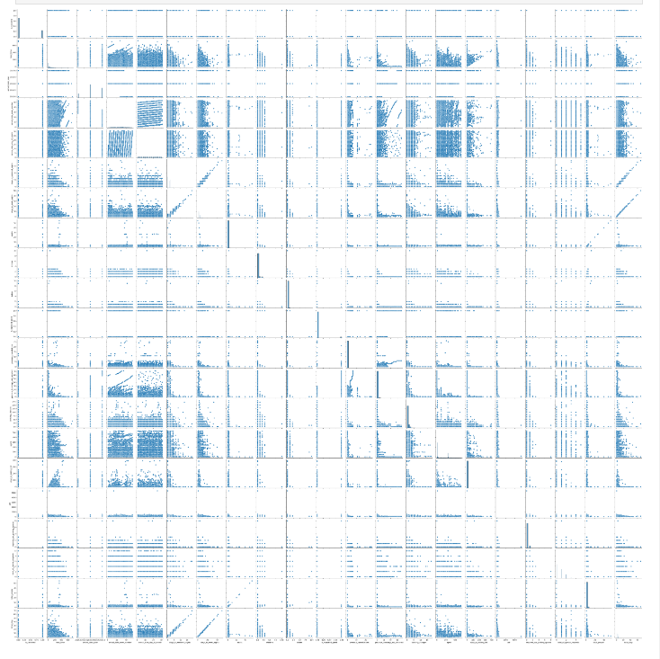
Pair Plot

Slide 24

THANK'S FOR READING
Mustafa - Top Rated Data Analyst

